Slide 1


SMART INDIA HACKATHON 2024
Problem Statement ID - 1687
Problem Statement Title - Realtime Disaster Information Aggregation software
Theme - Disaster Management
PS Category - Software
Team ID - 12293
Team Name - EPIC ENGINEERS

Slide 2







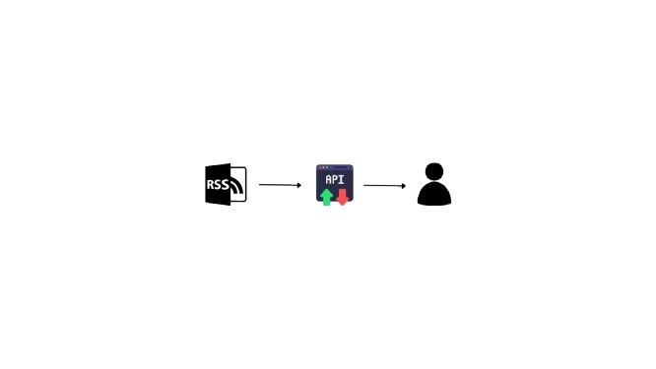
Realtime Disaster information Aggregation software
EPIC ENGINEERS
PROPOSED SOLUTION
Develop software to aggregate, and display disaster-related posts using an API and RSS feed.
Build an API to aggregate data from a source API.
Collect posts using specific hashtags from the source API.
Fetch news posts using specific keywords through RSS feeds.
Display the processed data on a user-friendly dashboard.
NOVELTY
Display disaster news on the website with a share button for NDRF teams to request manpower, ensuring a quick response.
Analyze data to trigger alerts for critical information requiring immediate action.

Slide 3


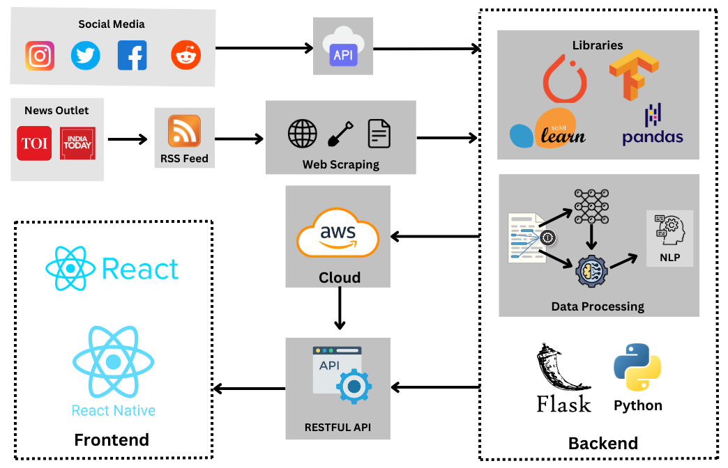









TECHNICAL APPROACH
EPIC ENGINEERS
Flow Chart
Tech Stack

Slide 4

CHALLENGES AND FEASIBILITY
EPIC ENGINEERS
FEASIBILITY OF THE IDEA
Using frameworks like React and APIs enables real-time disaster data aggregation and sharing.
RSS feeds offer a reliable way to fetch news from multiple sources, ensuring seamless integration.
The project utilizes open-source tools and APIs to keep costs within budget.
POTENTIAL CHALLENGES
Collecting real-time social media data and RSS feeds is possible, but requires managing API limits and data quality.
Sentiment and semantic analysis can help filter out misinformation by assessing tone and context.
API Limitations
Real Time data Aggregations
Open Source Tools and Cost Efficient
Misinformation
Multiple Sources

Slide 5



IMPACT AND BENEFITS
EPIC ENGINEERS
POTENTIAL IMPACT ON THE TARGET AUDIENCE
Our solution provides real-time, aggregated data from social media and news, reducing response time and potentially saving more lives.
The region-based sharing feature enhances coordination, allowing local teams to deploy resources more efficiently across areas.
BENEFITS OF THE SOLUTION
By filtering out irrelevant information, the platform ensures response teams focus only on actionable data, improving crisis management efficiency.
Sentiment and semantic analysis help filter misinformation, ensuring only accurate and verified data is presented, boosting information reliability.
1
2
3
4
Reduce response time and saving more lives
Region based sharing features
Filtering irrelevant data
Boosting Reliability

Slide 6

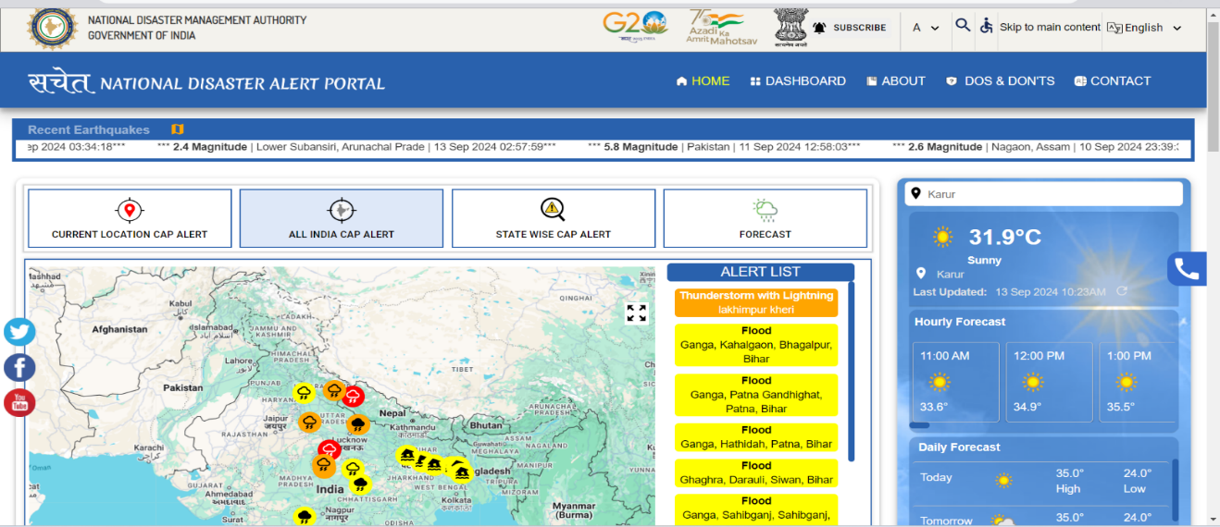


RESEARCH AND REFERENCES
EPIC ENGINEERS
https://sachet.ndma.gov.in/ National Disaster Management Authority
Graph API
(Instagram , Facebook)
Reddit API(Reddit)
Twitter API V2(X)
RSS feed for News Portals

